Slide 1
Casting For Connections
Community Marketing and Resident Events
Facilitated by: Missy Behrns, Kate Vespa, Stacey Derrington, Stephanie Tayloe

Slide 2
Mission Statement
Our goal is to use the 4 philosophies of FISH! and implement them into our resident events and marketing. We will emphasize Choosing Your Attitude to bring positive energy, the importance of building connections through Play, Being There for your team and community, and creating fun experiences with the goal being to Make Their Day and leave a memorable impression!

Slide 3
Ice Breaker!

Slide 4
How Do We Incorporate FISH! Into Marketing and Resident Events?!
Choose Your Attitude
Choose to bring a positive energy to the community.
Put your best foot forward (along with the property’s) in marketing and events!
Play
Gear your marketing and residents events to your demographics to get the highest participation rate.
Make it fun for the residents, your team, and anyone involved.
Be There
Be fully present and engaged.
Don’t just go through the motions, make the true effort to build relationships.
Make Their Day
MAKE IT MEMORABLE! Make the interactions leaving the other person feeling GREAT!
Have different prizes at events. Take food, gifts, etc. when marketing.

Slide 5
When Marketing Goes Wrong!
How can this relate to our marketing and event efforts?

Slide 6
When Marketing Goes Wrong!

Slide 7
Based on a Survey of 30,000+ Renters
99% said they wanted to see details, apartment-specific information such as availability, photos, and exact floor plans to help paint a vivid picture and clearer understanding on where they’ll be living.
What does this mean for us and
our marketing efforts in 2025?

Slide 8
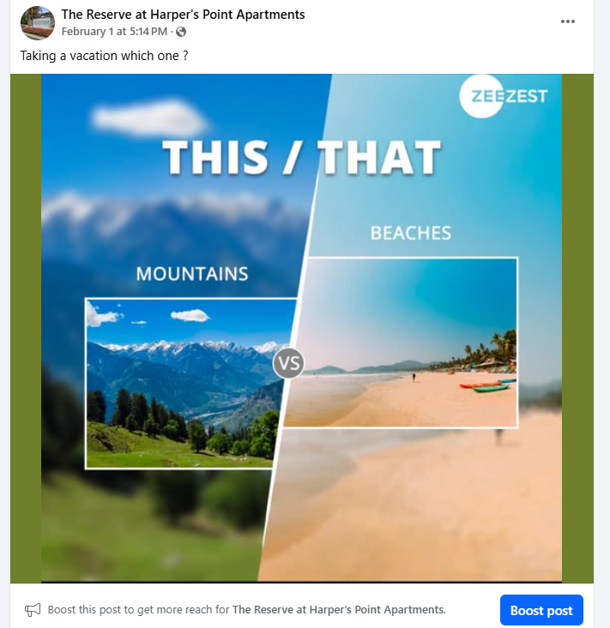
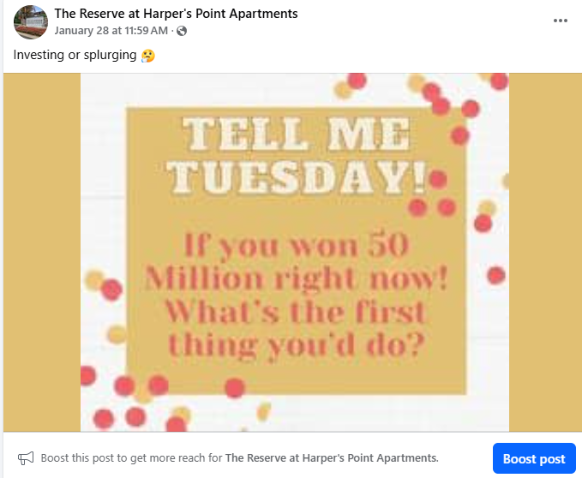
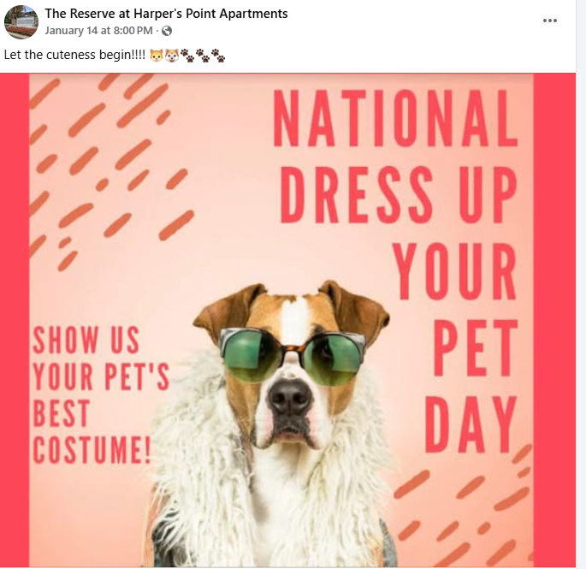
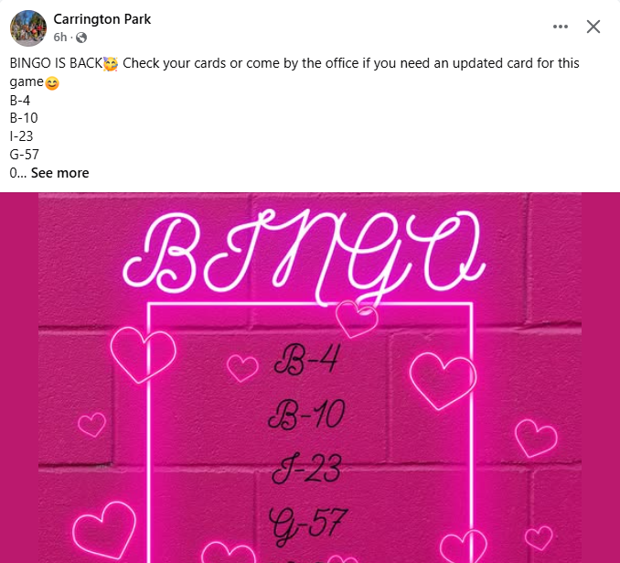
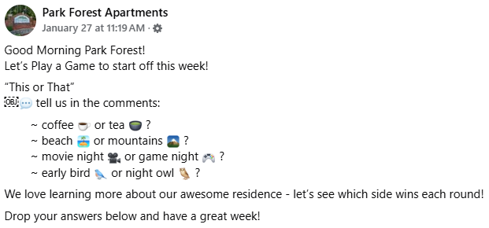
Social Media – Why’s It Important?!

Slide 9
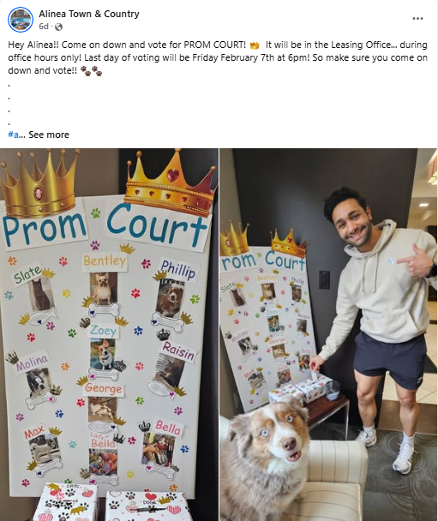
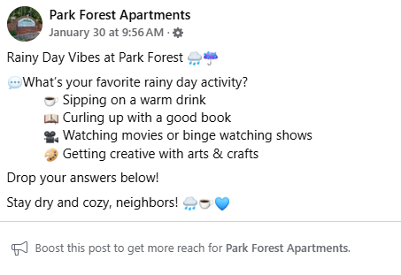
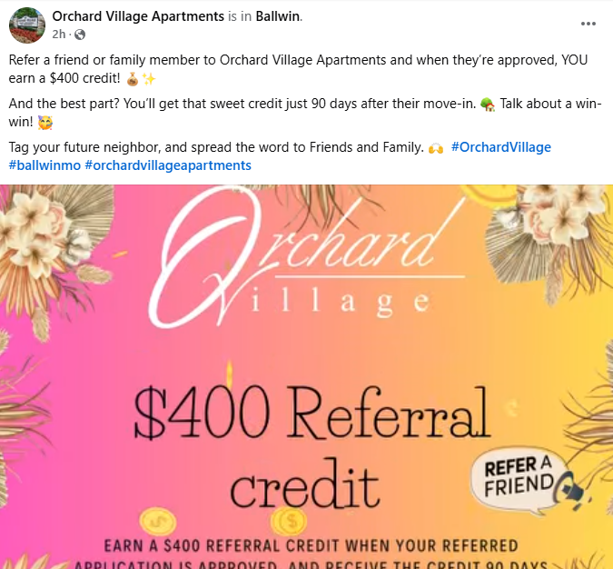
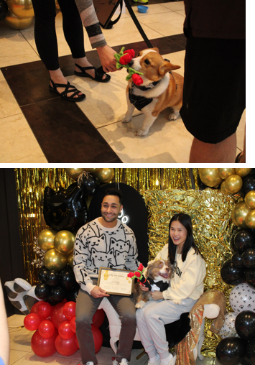
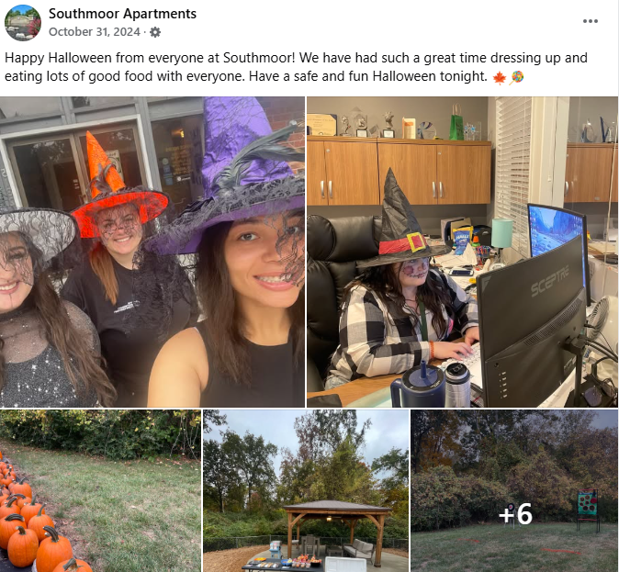
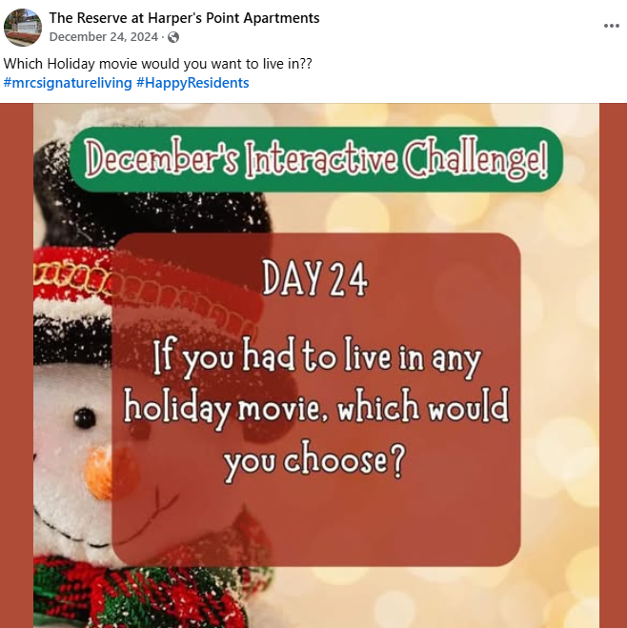
Social Media – Why’s It Important?!

Slide 10
Outreach Marketing
What type of outreach marketing has been effective for everyone?
What techniques can make outreach marketing more effective in 2025?

Slide 11
Resident Events
Why do we need them?
What are the goals of resident events?
What are some unique ones you’ve done or plan to do in 2025?

Slide 12
Resident Events
FISH STICKS EXERCISE!!!

Slide 13
Resident Event #1

Slide 14
Resident Event #2

Slide 15
Resident Event #3

Slide 16
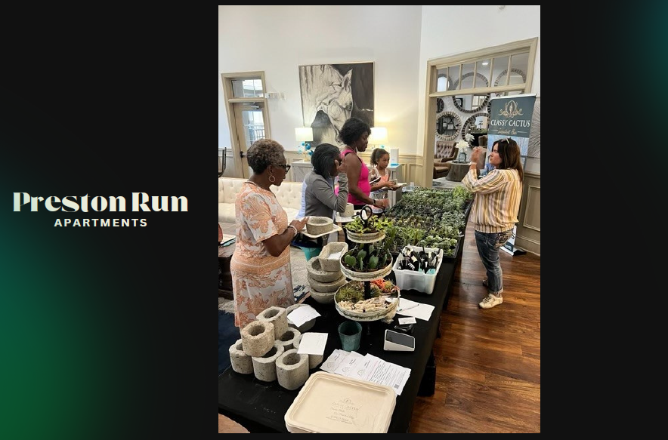
Resident Event #4

Slide 17
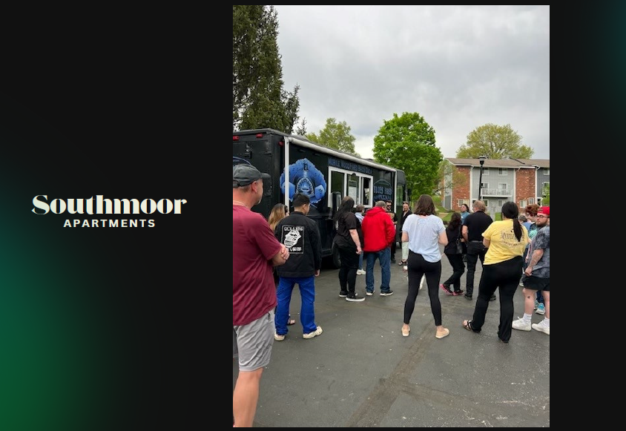
Resident Event #5

Slide 18
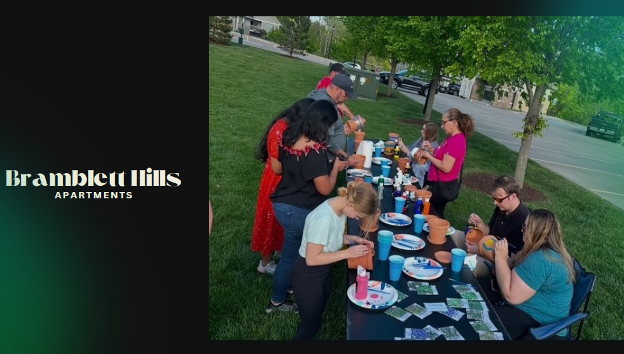
Resident Event #6

Slide 19
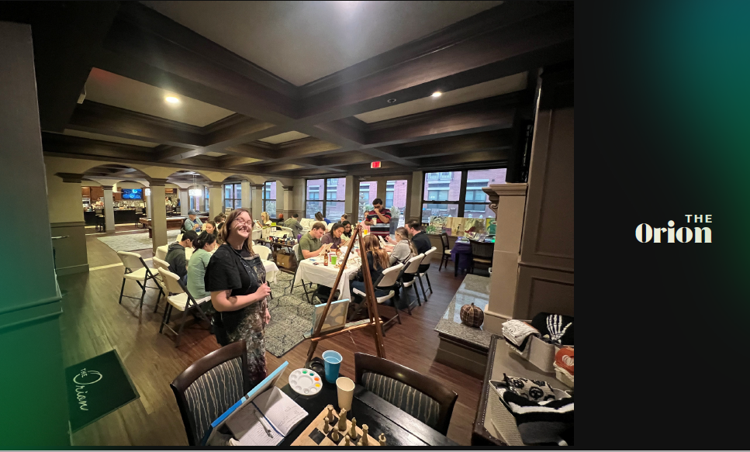
Resident Event #7

Slide 20
Resident Event #9

Slide 21
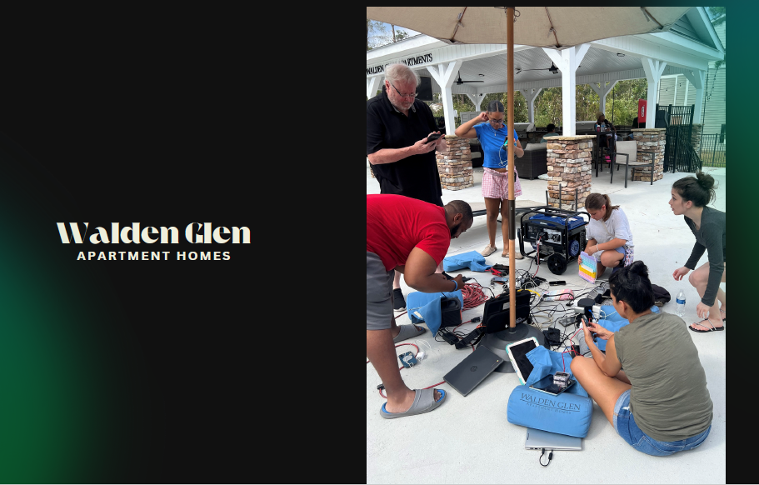
Resident Event #10

Slide 22
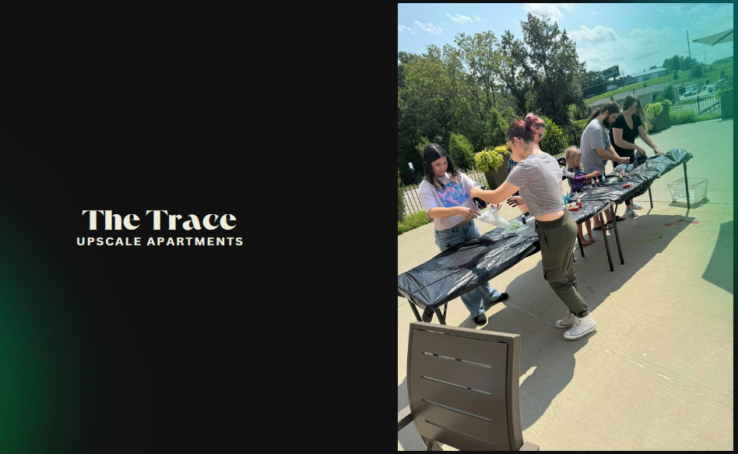
Resident Event #11

Slide 23
Resident Event #12

Slide 24
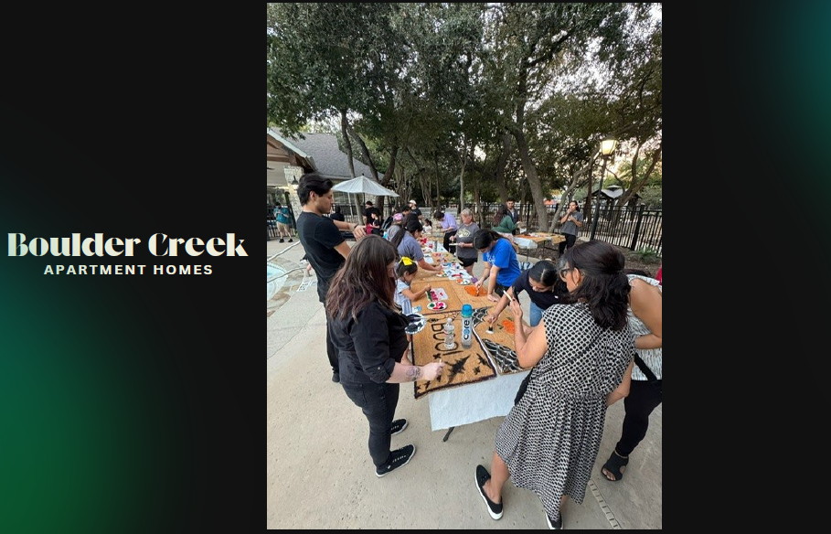
Resident Event #13

Slide 25
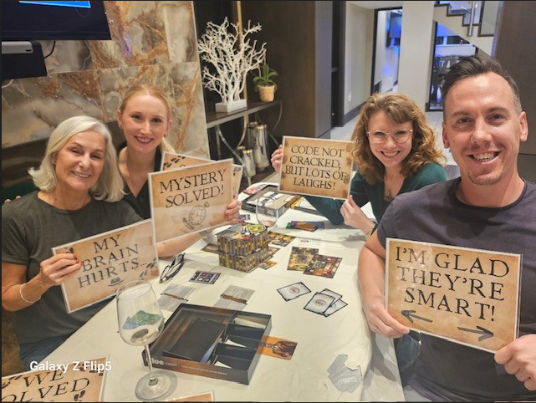
Resident Event #14
Alinea Town & Country

Slide 26
Reviews, Reviews, Reviews!
How do reviews and marketing go hand-in-hand?
How do you best show your reviews to a target audience?
What are resident reviews so valuable?
What are we doing and what else can we do to get positive online reviews?
How do we address negative online reviews?

Slide 27
Conclusion
What did we learn that we can take away to our communities?!

